Slide 1
Objective 7
User input with functions

Slide 2
ILO’s
Learning outcomes
Be able to create and use well-defined interfaces to subroutines, using parameters and return values. Use string handing operations and the Boolean and char data type.

Slide 3
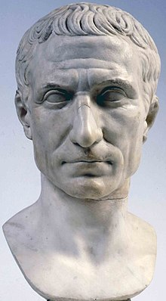
User input
We need to know how to handle user input and pass this information into different functions
User input should only be asked for at the start of the program to enable efficiency
Exercises:
Develop a script that will take user input and return it as Morse code
Develop a Caesar Cipher that requires a phrase and a shift
Also enable a decipher!

